Slide 1
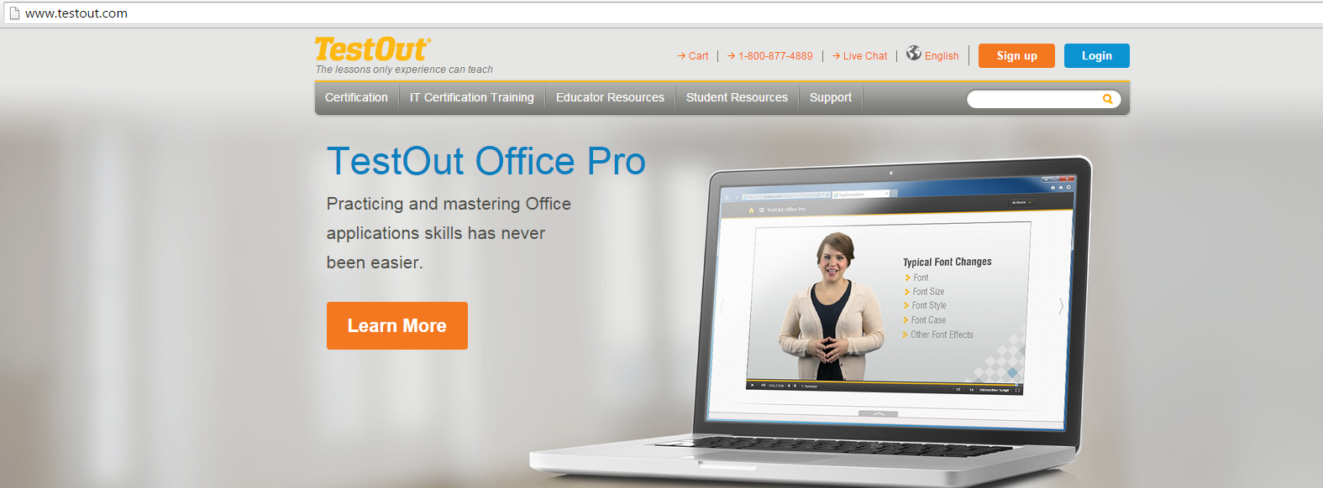
Setting up an Account
Go to www.testout.com
Click on ‘sign up’

Slide 2
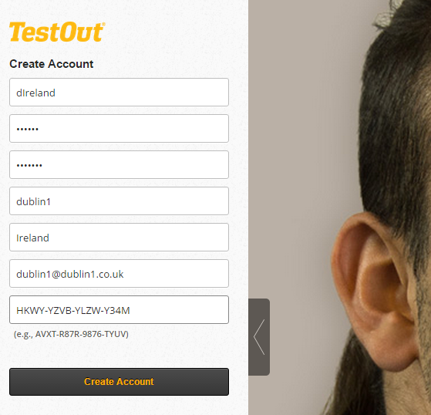
Please enter your personal details and take note of your password or use one that you may use for an existing email account
Enter your activation code
You will be prompted on the next screen to fill out some security questions

Slide 3
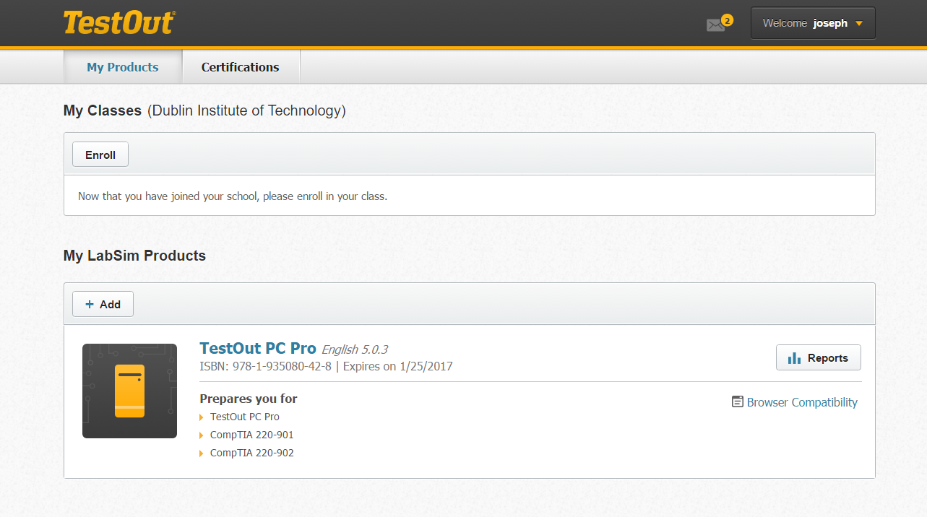
Enrolling on to your class
Click on to ‘Enroll’

Slide 4
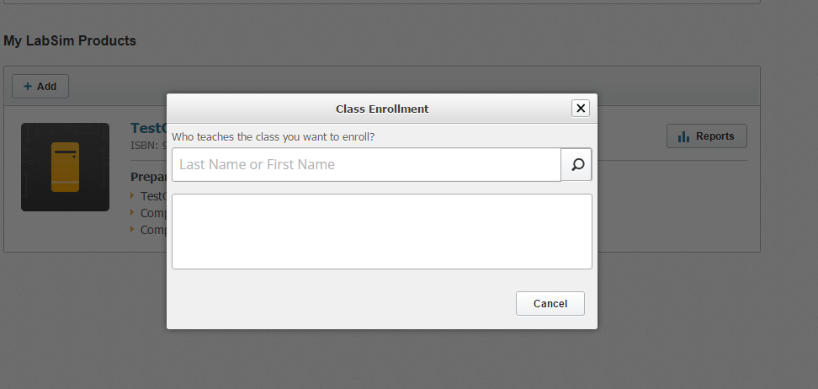
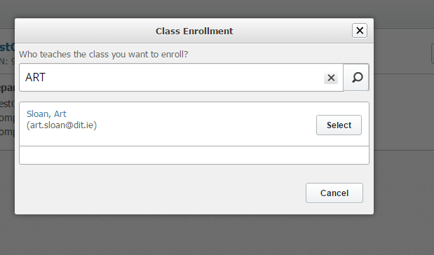
Type in your Instructor/teacher’s name for the course
Once you find the correct name click ‘Select’

Slide 5
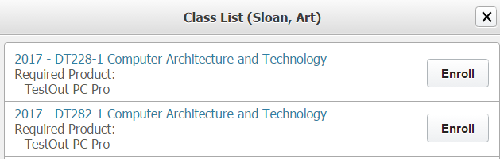
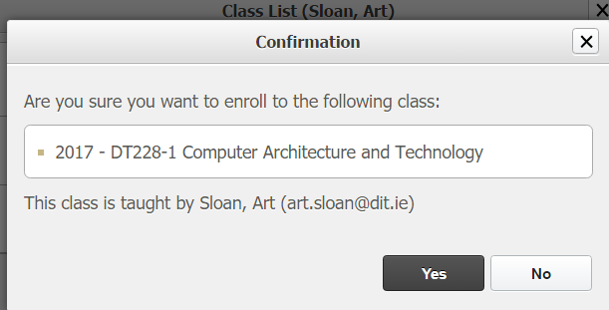
Please ensure you click on the correct course/module you are enrolling on to. Ask the Instructor/teacher if unsure.
Once you select the correct course/module click on ‘Yes’

Slide 6
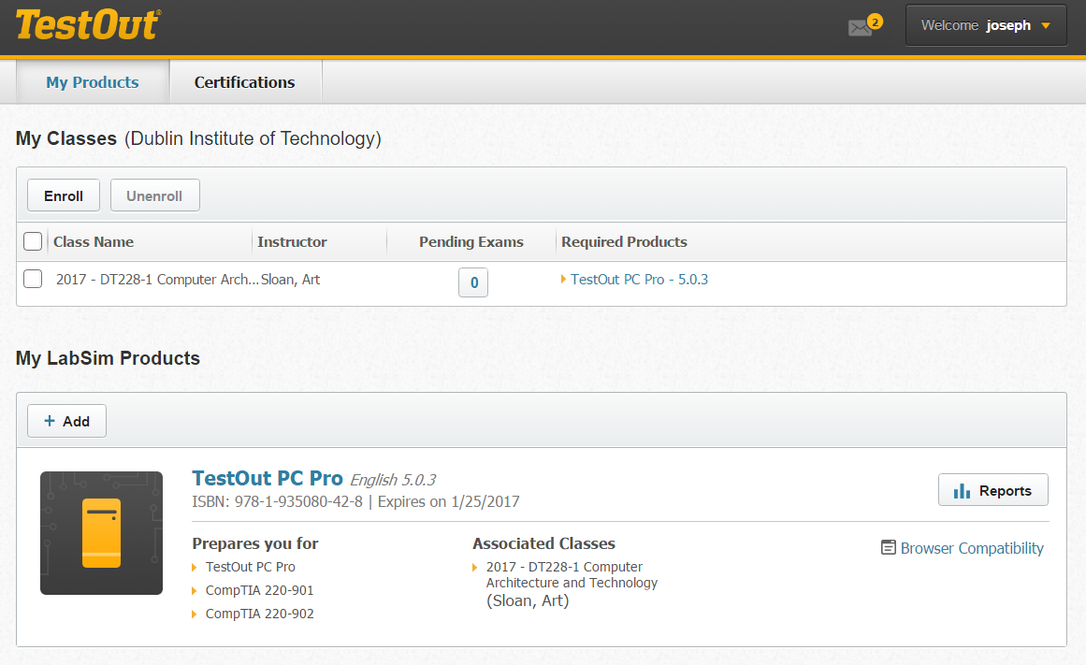
You will be able to see your class or classes.
To access the resources click here

